Slide 1
ETL ABC Framework
Audit Balance and Control
Presented By:
Naveen
Anirudh

Slide 2
Agenda
Need For Audit in ETL Jobs
Target Audience
Architecture
System Requirements
How it works.
Demo
Features of our framework
Future Scope
Questions
Notes:
Why do we need to Audit ETL Jobs.
Who is the Framework for.
What is required for the framework to work.

Slide 3
Need For Audit in ETL Jobs
Monitor ETL Jobs running in production and other environments.
Ensure all the required processes are executed in the correct order.
Provide current and historical information about the ETL job’s
Status
Load type
Performance
Data volume
Date range
Ensure ETL has moved the right amount of data from the correct source to the correct destination.
Notes:
Use Cases :
Identifying the problems within ETL process
Faster analysis posibility
Proactive monitoring
Analyzing and tracking Metrics like volume, Run times and record counts.
Restartability

Slide 4
Target Audience
Who is it for?
ETL Developers/ Data Integration Team
Support Team
Program level managers etc. (optional)

Slide 5








Data Warehouse Architecture
Enterprise Data warehouse
Reporting Layer/BI Tools
Data Integration and ETL Tools
Application Data (CRM,Finance , ERP)
EDW Tables
Summary Data
BI Dashboards
Datamart 1
Datamart 2
Data Ingestion/Processing
Business Transformation
Unstructured Data
Self service BI

Slide 6






Architecture – ABC ETL Framework
ETL Code
Source
ETL Logic/ Transformations
Target
ABC Framework
Stored Procedures
Reporting Layer/
BI Tools
Audit Logs
Balance/ Validation
Control
Error Logs
ABC Database

Slide 7
System Requirements
ETL Code:
Stored procedure calls at begin and end of the job
Database:
Dedicated schema
Tables, sequences, stored procedures, created etc.
Grants and roles
Reporting if required can be done on tools such as Tableau, Microsoft Power BI etc.

Slide 8
Process Flow
Master Jobs:
ETL Job Start
Create start entry in Audit tables for Master Job
Trigger Individual Job Process
Pass metric information and trigger Audit end process
ETL Job End
Individual Jobs:
ETL Job Start
Create start entry in Audit tables
ETL process
Pass metric information and trigger Audit end process
ETL Job End

Slide 9
Types Of Jobs
In ETL usually 2 types of jobs are maintained:
Individual Jobs: These are jobs/ processes that move data for a single source system from a tables or group of tables to a well-defined target table
Master Jobs: These are a collection of Individual jobs that move data for a single subject area
Terms Used
Application: The application where data is being moved to. It could be a central data warehouse, Datamart, lake house etc.
Source System: The origination system for the data. It could also refer to an upstream source system.

Slide 10
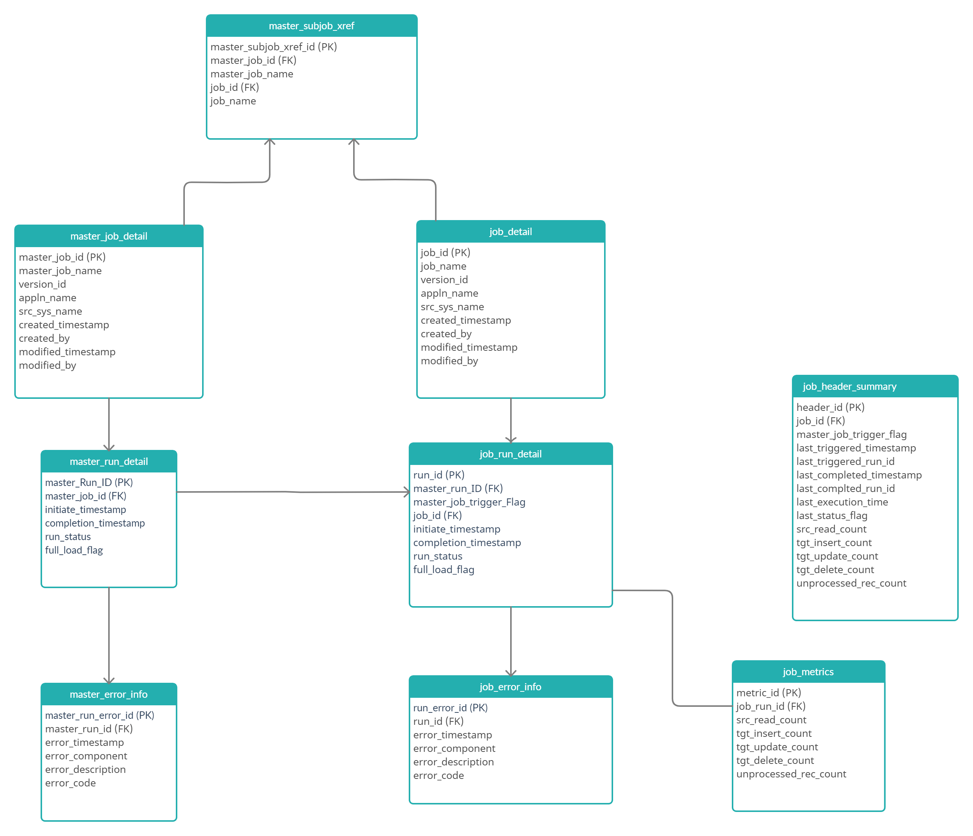
Data Model

Slide 11
Components Of The Framework
9 Tables and their associated sequences. Namely:
2 stored procedures:
audit_pre_execution
audit_post_execution

Slide 12
ETL Audit- Framework Demo

Slide 13
Monitoring Dashboards Demo

Slide 14
Features
Independent of initial DML (Data Manipulation Language) scripts.
Easily adaptable and simple design.
Audit trails being captured at point in time with relevant job run status.
Reporting capability for support standpoint.
Centralized monitoring of the ETL Loads and various relevant metrics.
Allows customization of reports where required

Slide 15
Future Scope
Audit control for the incremental loads/Historical loads.
Centralized maintenance of Context values.
Cleanup of the stale data/ retention policy.
Custom metrics.
Log capturing capability.
Restart-ability of ETL jobs.
Security controls
Notes:
Analytics.
Integration with ELK Stack.

Slide 16
Questions?

Slide 17
Thank You

